Slide 1

Bangladesh Army University of Engineering and Technology (BAUET)
Department of Computer Science and Engineering (CSE)
Course Code: CSE 4106
Course Title: Software Development for Web Applications Sessional.

Slide 2

“Ask Me” The android web browser !
Md. Rashadul Alam (16104050)
Md. Shahadat Hossain (16104020)
Golam Mahiuddin Khan Ta-seen (16104096)

Slide 3

Outlines…
Why “Ask me” web browser ?
Functions of web browser.
Software already Available.
Overview of the proposed application.
Application’s brief.
Technology to be used.
Software Development Model.
Future work.
Question sections.

Slide 4
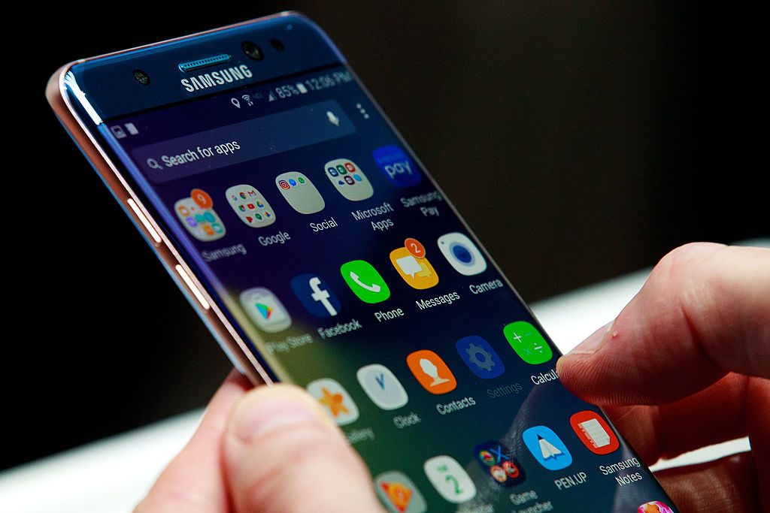
Why “Ask Me” web browser ?
Age of internet connectivity.
Internet accessibility is a core need in everyday life.
To facilitate the android system with the internet.
Browse almost all types of websites and web pages.
Browser is a widely used applications in android OS.
To develop a complete web browser.

Slide 5

Functions of web browser.
A web browser (commonly referred to as a browser) is a S/W application for retrieving, presenting and traversing information resources on the World Wide Web.
The primary purpose of a web browser is to bring information resources to the user , allowing them to view the information and then access other information .
This process begins when the user inputs a URL (Uniform Resource Locator). The most commonly used kind of URL starts with http:// and identifies a resource to be retrieved over the HTTP (Hypertext Transfer Protocol).

Slide 6




Software already Available.
Opera Mini
Known for its great user interfaces and low internet consumption.
UC browser
Probably the most popular browser for better user experience.
Chrome
Best for simple and easy UI and services.
Firefox
Competitive browser in the market for better services.
.

Slide 7
Overview of the proposed application.
Welcome Screen
(Splash Screen)
Search or URL box
Corresponding websites
Popular Websites
Popular Websites
Popular Websites
Popular Websites

Slide 8
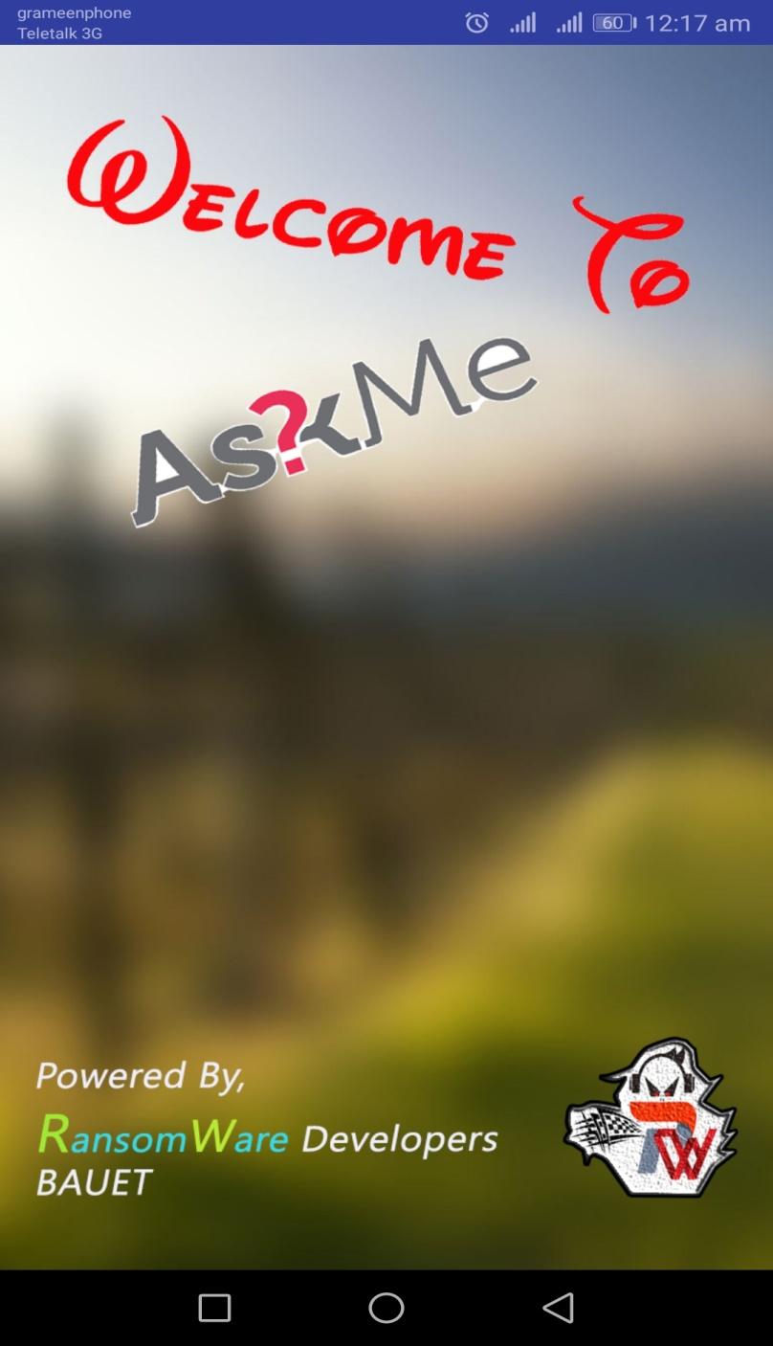
Application’s Brief (Splash Screen)
Browser Name
Developers Name and Team’s Logo
Note: The Splash Screen will appear for just 4 to 5 seconds…

Slide 9
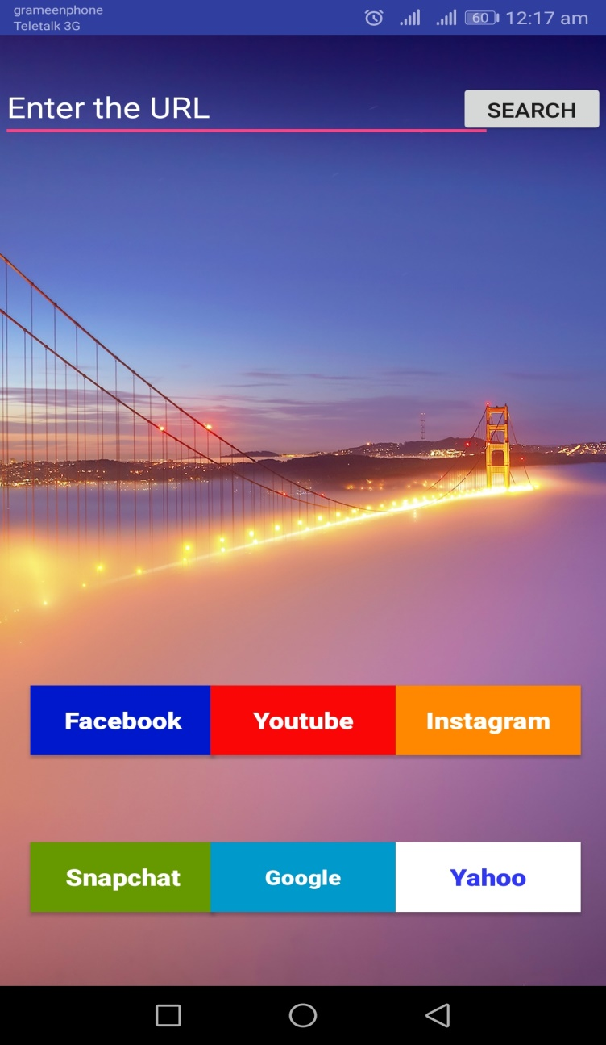
Application’s Brief (Main Page)
Search Button
Search or URL box
Background Image
System Time and Network Status Title Bar
Top Rated Web Links
Back Button

Slide 10
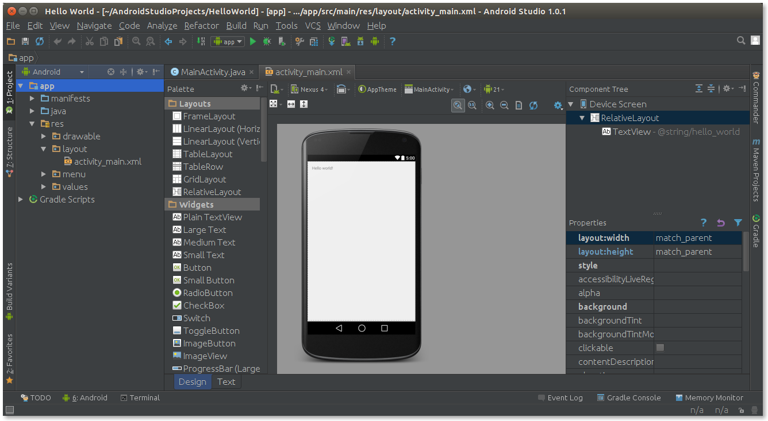
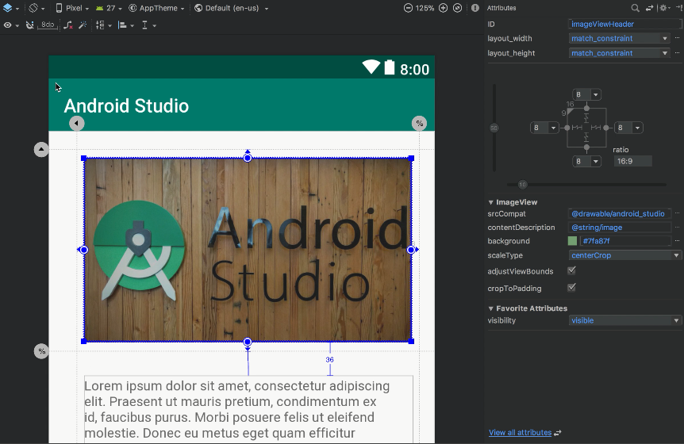
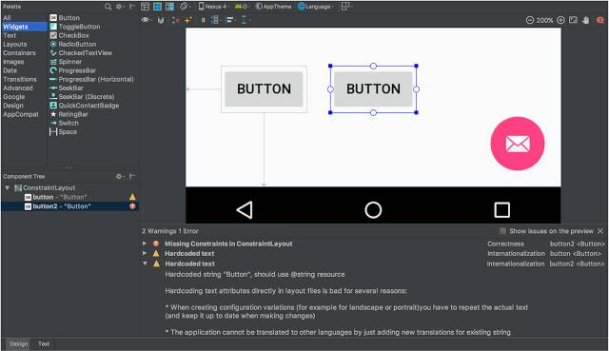
Technology to be used… (Android Studio)

Slide 11
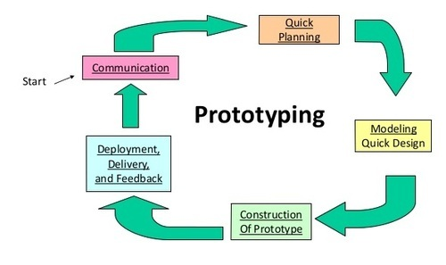
Software Development Model.
Prototyping Model:
Some reasons to use prototype model for the development areas follows:
Team is not experienced in this type of project before.
Probabilities of happening error is high.
Users are actively involved in the development
Since in this methodology a working model of the system is provided, the users get a better understanding of the system being developed.
Quicker user feedback is available leading to better solutions.
Missing functionality can be identified easily
Confusing or difficult functions can be identified

Slide 12
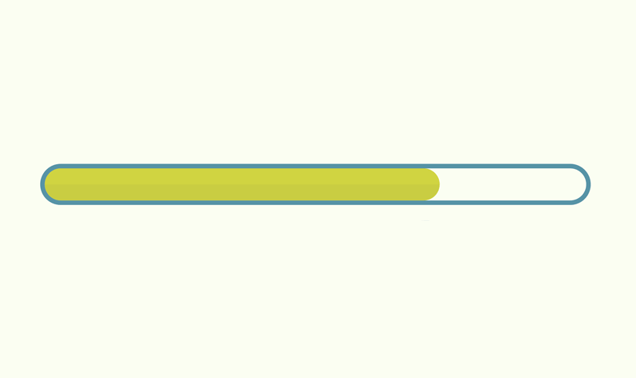
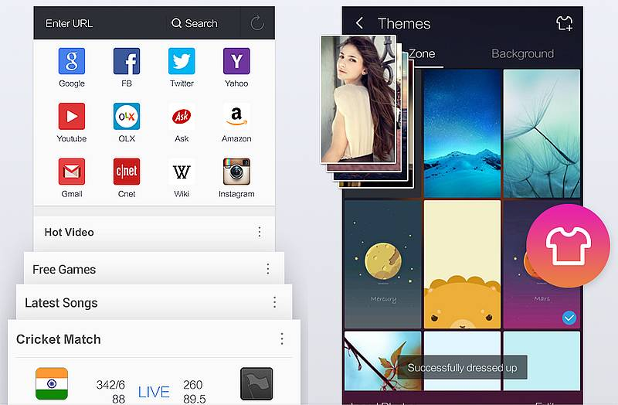
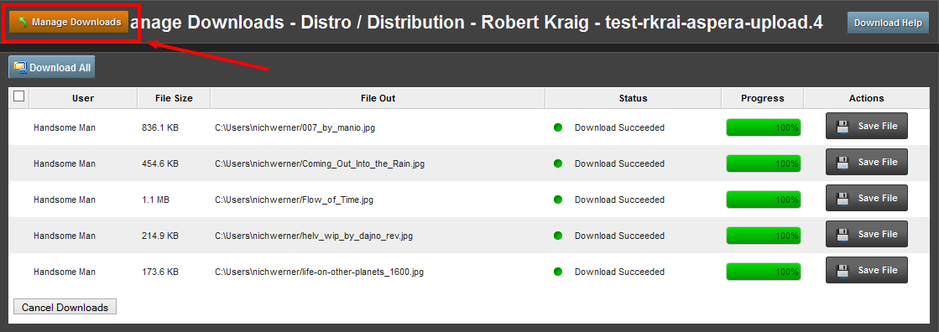
Future Plans…
Smart Progress bar Implementation.
New Tab option.
Theme changing option.
Smart download management.

Slide 13

Question Section:

